Slide 1
Config Driven Development (CDD)
8/11/2020

Slide 2
Agenda
Introductions
What is Config Driven Development (CDD)
Traditional development vs CDD
Sandbar
Demo
Next Steps
Questions
Notes:
Andrew

Slide 3

Andrew Evans
Manager at CapTech Consulting
10+ years industry experience
Full Stack
React, Angular, VueJS, more
Back-end JavaScript, Java, learning C# and more
Masters in CS from CNU
MBA from W&M

Slide 4

Ram Ramkumar
Senior Software Developer At CapTech Consulting
5+ years industry experience
Full Stack
React, Angular, VueJS
Node.js, C#
BS CS from University of Virginia

Slide 5
What is CDD?
At its core, CDD is a way of using modularity to build a loosely coupled set of components that are then composed together using a common interface
Independent components are built first, starting at the atomic level
An interface (usually JSON) is defined to compose the higher level UI
Combination of reusable components and JSON blueprint allows developers to easily define atomic components and build up and out
3 – Composed Interface
JSON config files
2 – parent containers
i.e. form container
1 – modular components
i.e. text field, radio group
Notes:
Ram

Slide 6
Traditional vs CDD
Traditional
CDD
Lead architects design around business requirements
Application built
Application deployed
Changes are done through additional components (SOLID Principles) or painful refactor
Building through dynamic composition
Can be changed through data rather than full rebuild
Easy to adjust and maintain
Scales as business needs change
Modular design means updates to components only need to happen in one place
Focuses error handling and catching
Notes:
Andrew

Slide 7
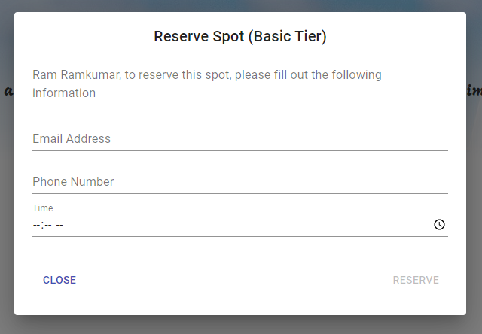
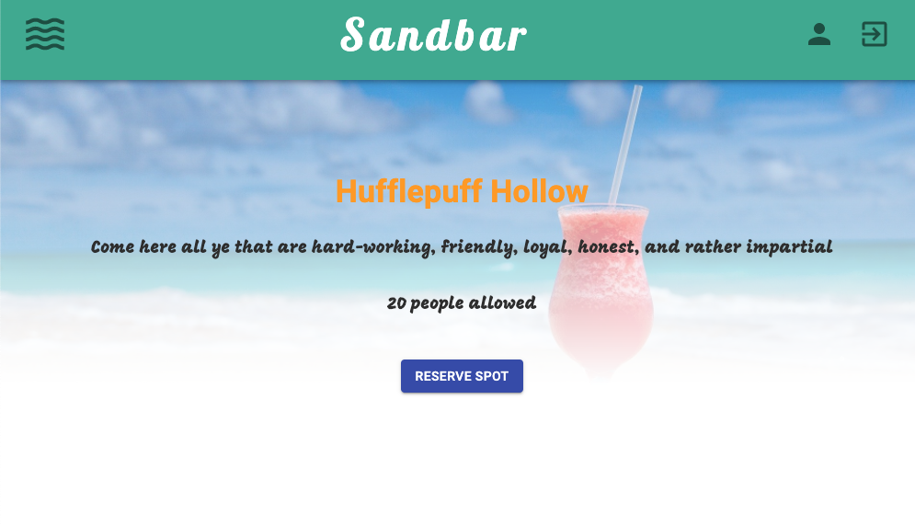
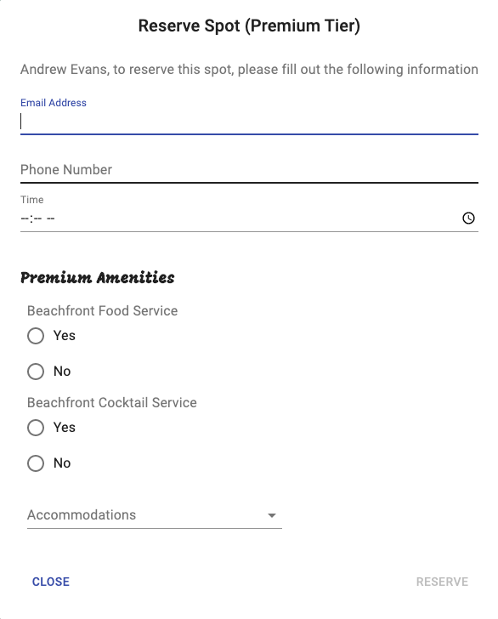
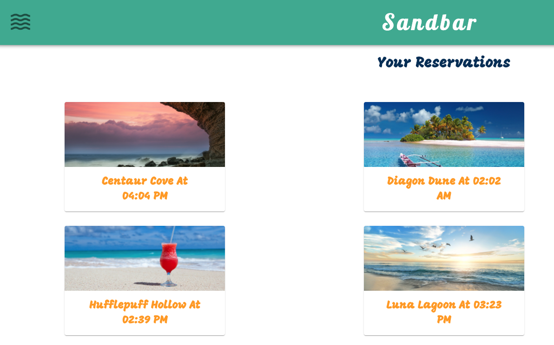
Sandbar
Manage going to a beach during quarantine
Schedules access
Basic login and logout
Reservations
ReactJS for the front-end
Azure Functions on the back-end
Notes:
Ram

Slide 8
Demo

Slide 9
Next Steps
Server Side Rendering (SSR) works nicely with CDD
Move config to API response
Easier maintenance and scaling
GitHub project for front-end
https://www.github.com/andrewevans0102/sandbar2
GitHub project for back-end
https://www.github.com/andrewevans0102/boardwalk2
Notes:
Andrew
*mention real examples from clients (Fortune 500 Car Retailer)

Slide 10
Questions

